Slide 1
Clock Lab
You need one partner and at least one cell phone stopwatch per pair. Trios and singles won’t work.
If you can’t find a partner, Mr. Arbuiso will work with you.
In this lab we will mix 2 solutions (over and over) to see if we can make the reaction happen faster, or slower.
Solution A is an iodine solution and clear. Solution B is a starch solution and milky.
When they mix together, they will react and turn a color ALL AT ONCE.
Your job is to mix the solutions in the proper concentrations and CLOCK THE REACTION TIME in seconds.
Rinse out the reaction beakers, and remix the solutions in the new concentrations, react and time them again. REPEAT.

Slide 2
Read the Lab Procedures before we get to the back of the room, but first, let’s review data table 1.
We will do SEVEN TRIALS, increasing the concentration of solution A each time.
Solution A + Water | Solution B | Time in seconds | Calculate the Rate of reaction unit is sec⁻¹
4.0 mL A + 6.0 mL water | 10.0 mL
5.0 mL A + 5.0 mL water | 10.0 mL
6.0 mL A + 4.0 mL water | 10.0 mL
7.0 mL A + 3.0 mL water | 10.0 mL
8.0 mL A + 2.0 mL water | 10.0 mL
9.0 mL A + 1.0 mL water | 10.0 mL
10.0 mL A + no water | 10.0 mL
For each trial, mix Solution A + Water properly
in a
graduated cylinder,
then
POUR BOTH cylinders into one
REACTION BEAKER
and start the timer.
Always swirl.
No spilling.
We’ll deal with
“RATE”
after we’re done.
Leave this column blank –
for now.

Slide 3
Procedure
10 mL B
6 mL Water
4 mL A
B
A
REACTION BEAKER

Slide 4
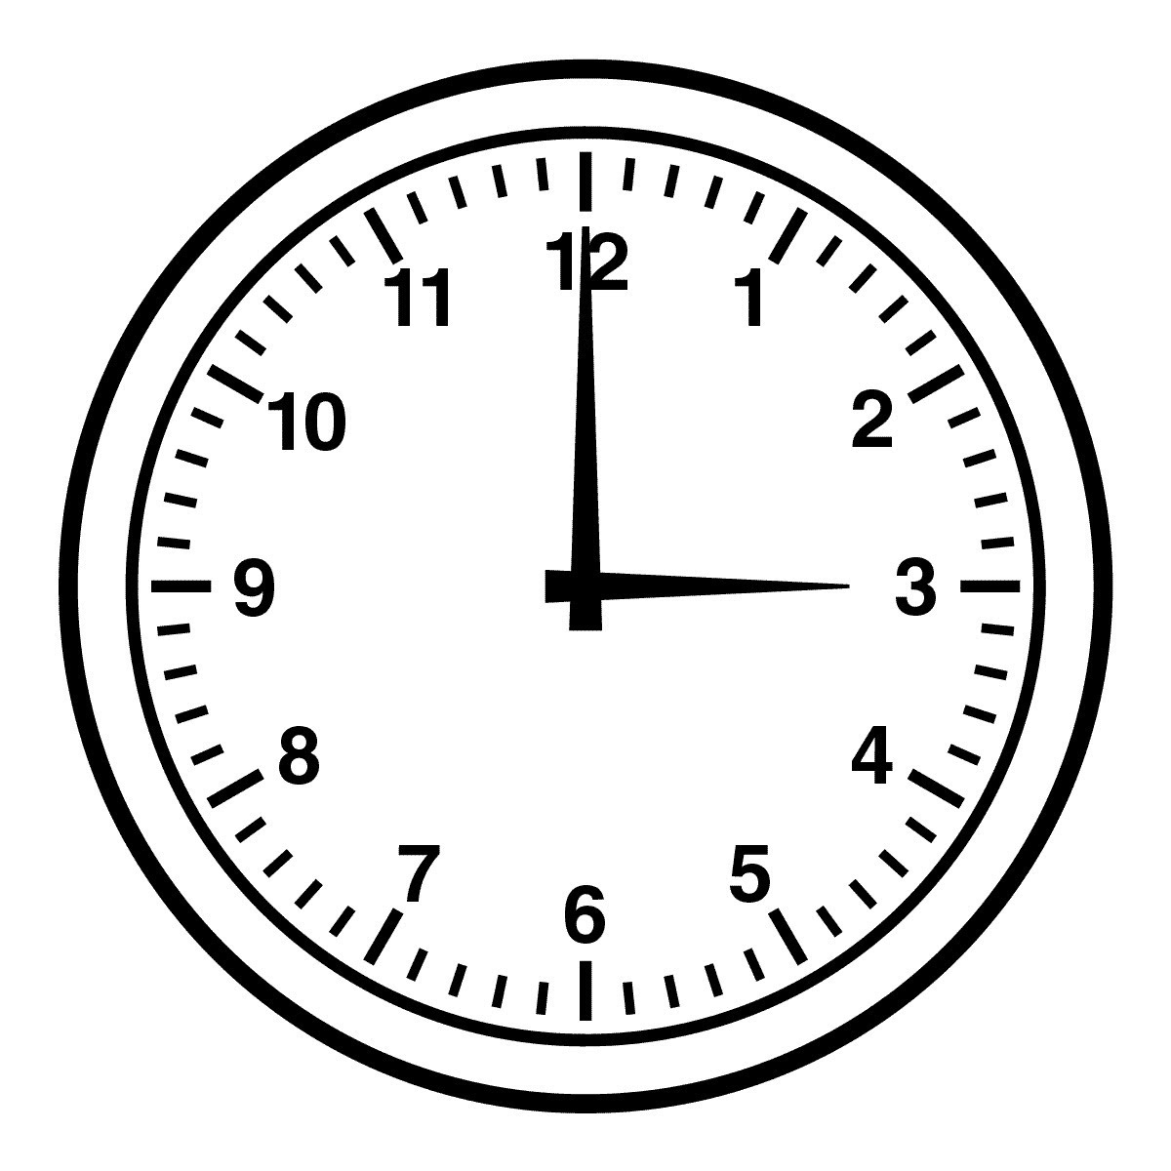
Procedure
A
B
Instantly start the timer, stop when
a color change occurs.
MIX SOLUTIONS
REACTION BEAKER

Slide 5
Second trial, no need to wash anything but the reaction beaker.
Refill “A” side as shown in data table, and
same 10 mL of solution “B”.
Get ready to time again, react & repeat.
Only rinse the reaction beaker.
10 mL B
5 mL Water
5 mL A
B
A
REACTION BEAKER

Slide 6
Important things to note…
Do not touch the 2 graduated cylinders, you will cross contaminate the solutions and waste everything.
If you do touch them together, you MUST rinse them. Don’t make believe it didn’t happen if it does my mistake.
Measure properly, take a few moments to be sure.
Keep A on the left, Keep B on the right, always put your tools down on your placemats, to keep track of things.
Don’t rush. Make sure you get at least one recording of the reaction changing colors.
Do not tell your friends in later classes what to expect, let them be surprised.
Part two of the lab will be a group effort.
Instead of varying the solution concentrations, we will vary temperature.
Each team will sign up for one or two trials.
In each trial we will use the same 8 mL of A and 8 mL of B. That is different.
In part 2 we will vary temperature.
Let’s look at that data table now.

Slide 7
Copy this data from board, do the averages, use average time for graphing. |  |  | Average the time for both trials | Calculate the Rate (this is a DECIMAL)
Temp °C | Team 1 Seconds to react | Team 2 Seconds to react
10
20
30
40
50
60
You and your partner will CHOOSE one or two temperatures to run the second part of the lab.
Let’s say you choose 10°C
You will need to get your two tubes of
8 mL solutions to exactly that temperature, probably using an ice water bath (shown in your lab handout).
If you choose a hot temperature, say 50°C, you will need to put your water bath onto a hot plate.
Use the thermometers. Measure exactly.
The whole class is counting on you to get a perfect temperature, and a perfect reaction time.
We will all use the average data.
We’ll deal with
“RATE”
after we’re done.
Leave
this column blank –
for now.

Slide 8
Math is easy.
Time is measured in seconds, nearest whole number every time.
Rate is not time, but they are related.
If you drive from home to school really fast, it takes less time. A higher rate of speed corresponds to less time.
If you take a slow drive, then you take more time. A lower rate of speed corresponds to more time.
Rate =
_____1_____
time in seconds
The relationship is INVERSEY PROPORTIONAL.

Slide 9
You must make 2 graphs today. Both really big, both with rulers and excellent scales that start at 0,0 and have NO BREAKS.
Rate as a function of solution A concentration
Rate as a function of average temperature of the solutions
There will be NO DATA for 0 mL of solution A,
nor for 1, 2, or 3 mL of solution A.
Your data starts with 4 mL
Your best fit line will start at 0,0 anyways
Rate
sec⁻¹
Concentration solution A in mL

Slide 10
You must make 2 graphs today. Both really big, both with rulers and excellent scales that start at 0,0 and have NO BREAKS.
Rate as a function of solution A concentration
Rate as a function of average temperature of the solutions
There will only be data for 10, 20, 30, 40 , 50,
and 60 centigrade.
Your best fit line will
start at 0,0 anyways
Rate
sec⁻¹
Goggles on
at all times.
Go!
Temperature in centigrade

Slide 11
Copy this data from board, do the averages, use average time for graphing. |  |  | Average the time for both trials | Calculate the Rate (this is a DECIMAL)
Temp °C | Team 1 Seconds to react | Team 2 Seconds to react
10
20
30
40
50
60
You and your partner will CHOOSE one or two temperatures to run the second part of the lab.
Put your initials into the box that you choose (or 2 boxes).
Later you will make your solutions the exact temperature and run your trial.
When you are done, erase your initials and put in your time in seconds, rounded to the nearest whole number.
We’ll deal with
“RATE”
after we’re done.
Leave
this column blank –
for now.
I love chem, the end.

